Slide 1
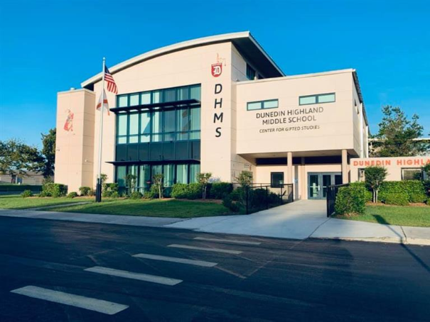

Dunedin Highland
Middle School
Where we conduct ourselves with Respect, Excellence and Pride!
Principal Assistant Principals
Michael Vasallo Diana Dolan, Joanna Bernal

Slide 2

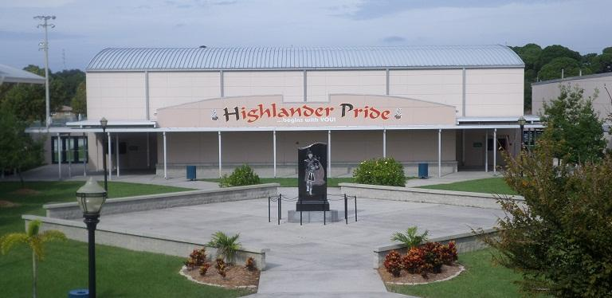
6th Grade Assistant Principal
Mrs. Dolan
(727) 469-4112 Ext. 2015 doland@pcsb.org
6th Grade School Counselor
Mrs. Northcutt
(727) 469-4112 Ext. 2060 northcuttc@pcsb.org
6th Grade Office Clerk
Ms. Herbert
(727) 469-4112 Ext. 2052 herbertk@pcsb.org
WELCOME TO
6th GRADE!

Slide 3
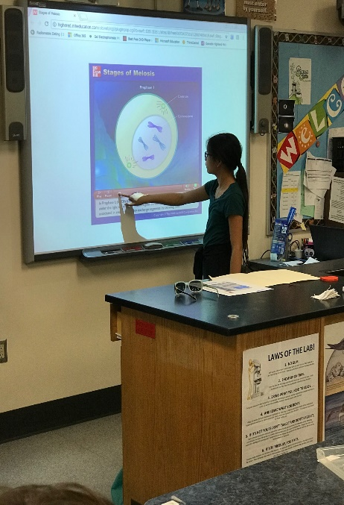
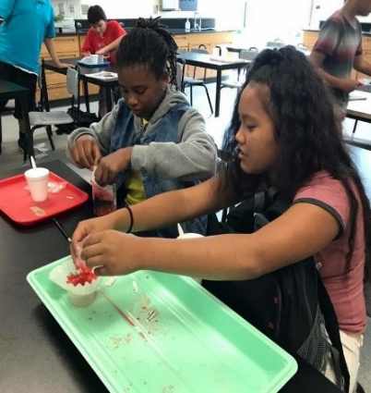
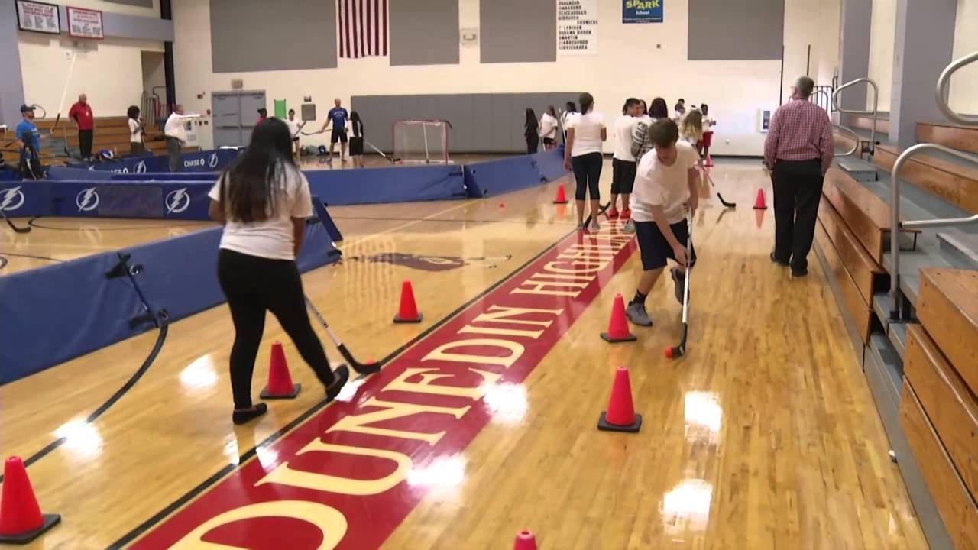
CLUBS & SPORTS
Middle School is a GREAT Time to Get Involved!
SPORTS
Volleyball, Basketball, Track, Flag Football, Intermural sports
CLUBS
5000 Role Models, Chess Club, Drama Club, Girlfriends, GSA,
Kiwanis Builders Club, Microsoft Certification Club,
NHD Club (National History Day), Odyssey of the Mind,
PMAC (Principal’s Multicultural Advisory Committee),
SAVE (Students Against Violence Everywhere), Science Olympiad,
Spanish Club, STEM Club, Leadership Team, Makerspace, and Yearbook.

Slide 4


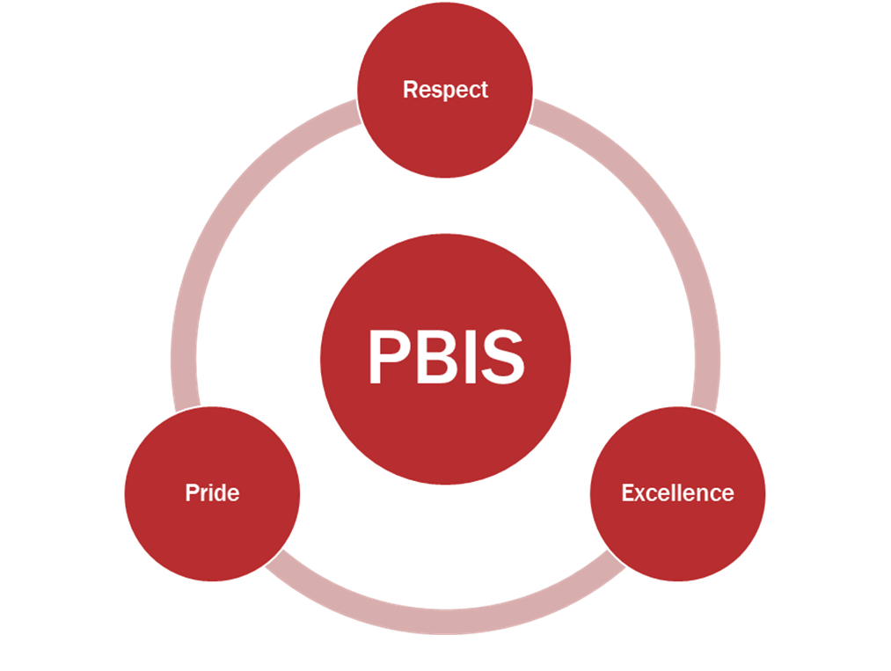
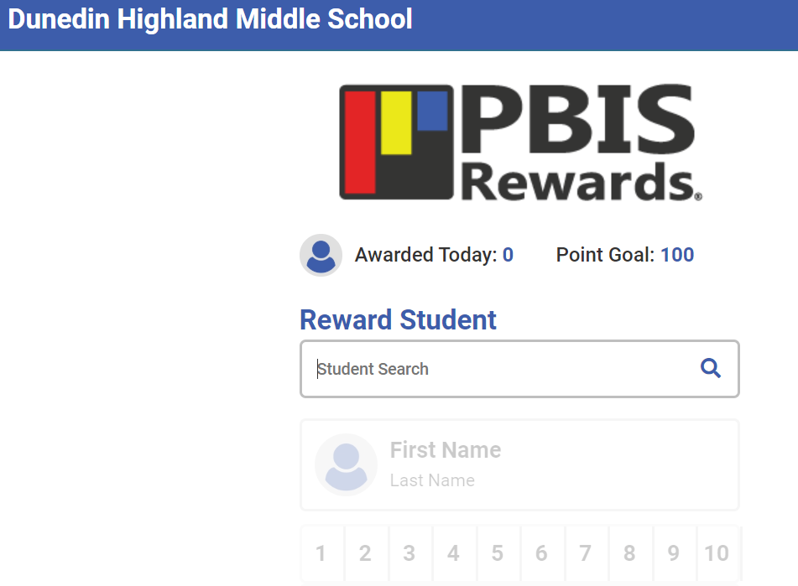

Positive Behavior Interventions and Support

Slide 5
What will my day look like in middle school?
7 Period Day
The seven periods include:
• 4 Required Adv/Acc Courses (Language Arts, Math, Science and Social Studies)
• (Level 1-2 students only) – Reading course
• Physical Education (Unless a PE Waiver is submitted)
• 1 - 2 Elective courses
• (CGS only) – All students must take the Advanced Academics Gifted Elective Course. They may select the Literature course as an elective, but it is not required.
•30 minutes of lunch daily
•3 minutes of passing time between classes

Slide 6
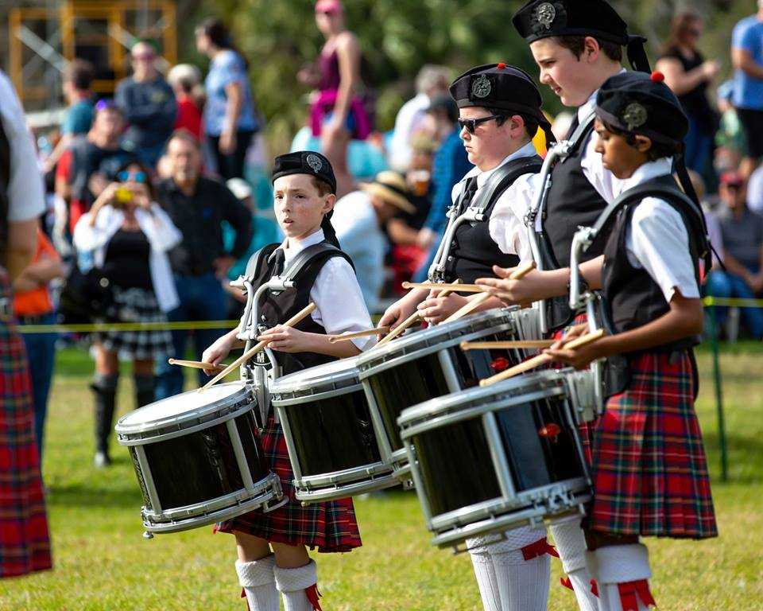
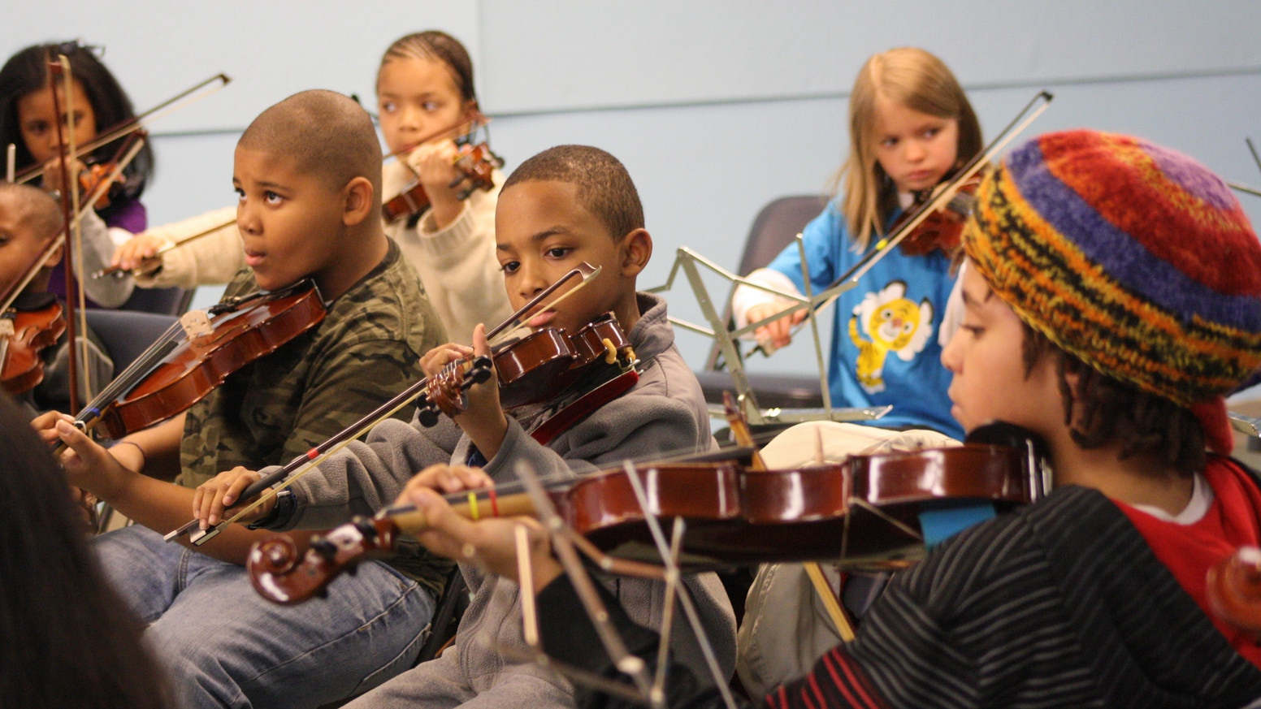
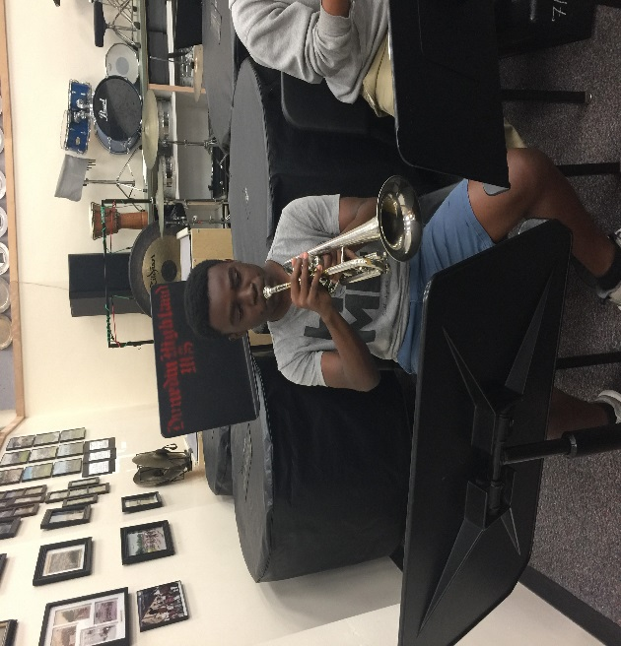
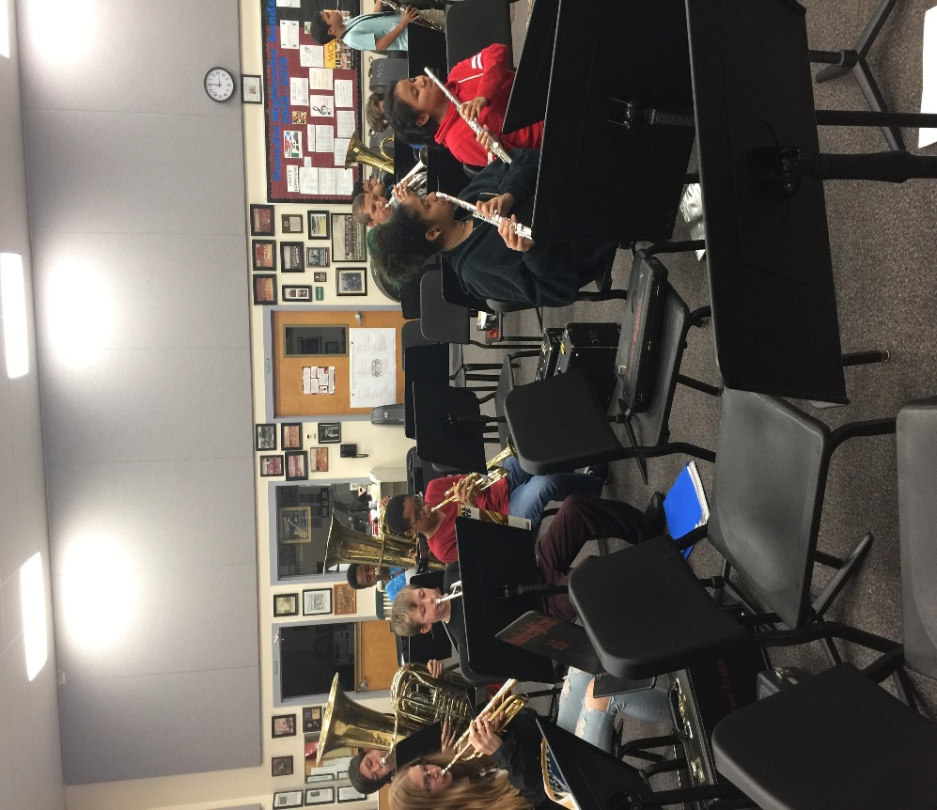
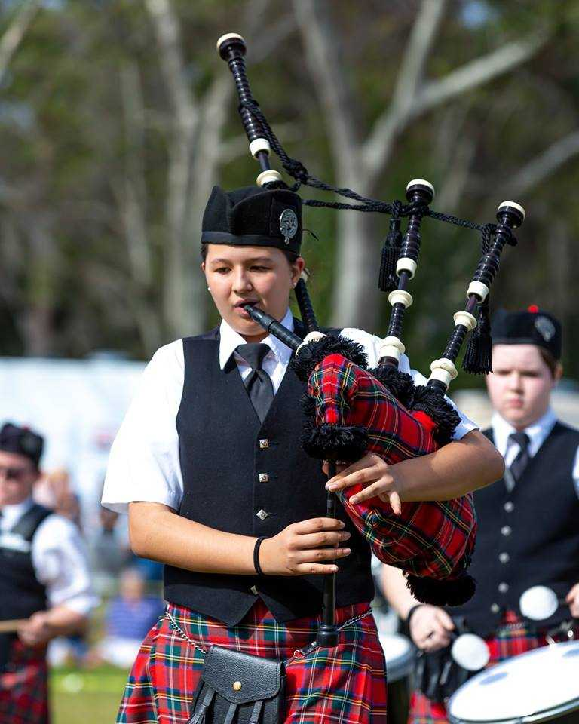
BAND and ORCHESTRA
Are you interested in learning a new instrument?
Are you passionate about music?
Are you a future Highlander looking to become a piper and compete on the local and even national level?

Slide 7
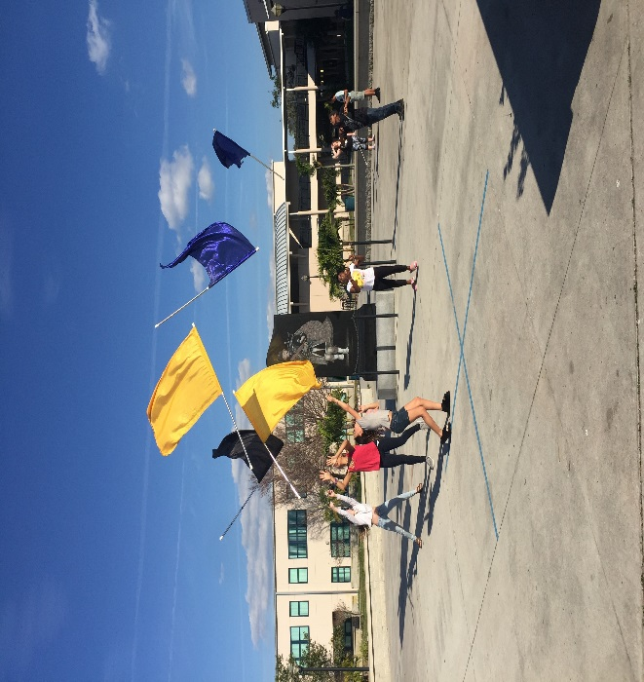
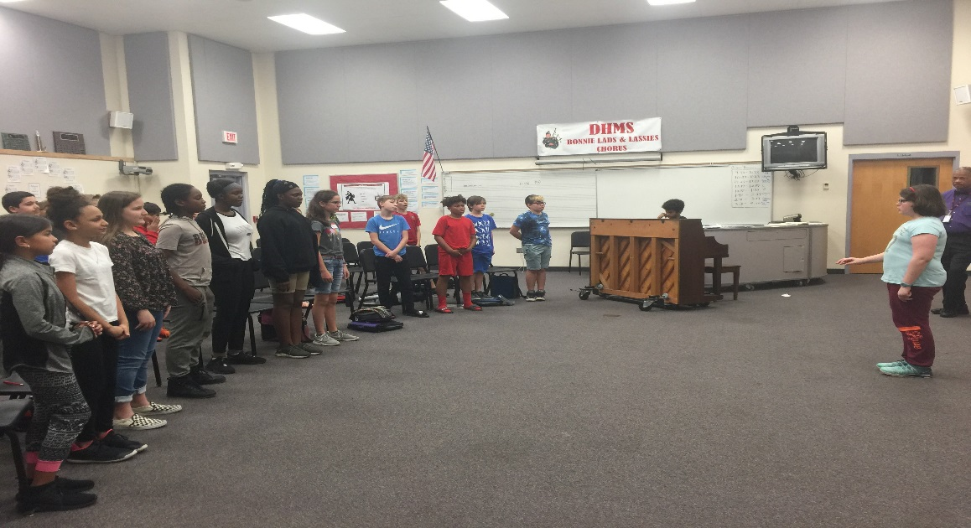
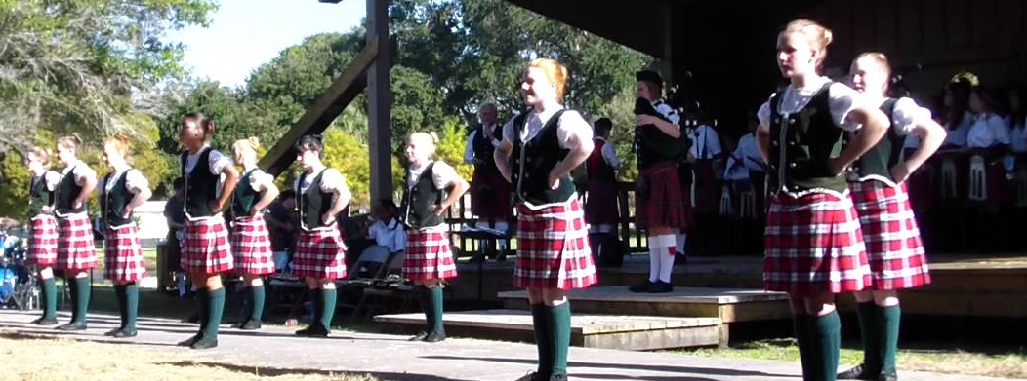
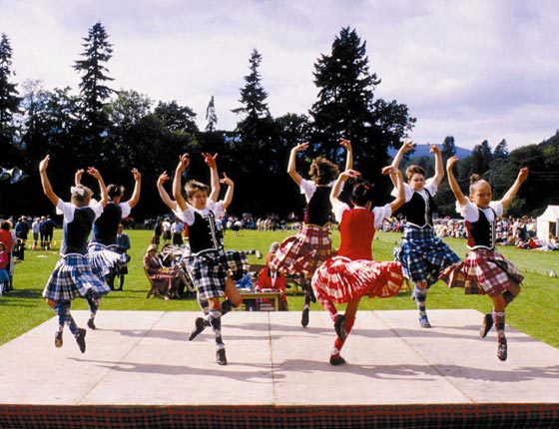
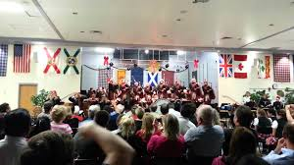
DRILL & SCOTTISH DANCE
Are you a performer?
Are your ready to experience the joy and precision of drill team and dance?

Slide 8
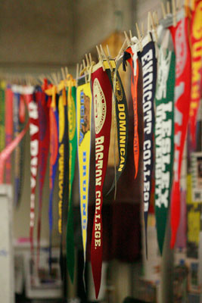
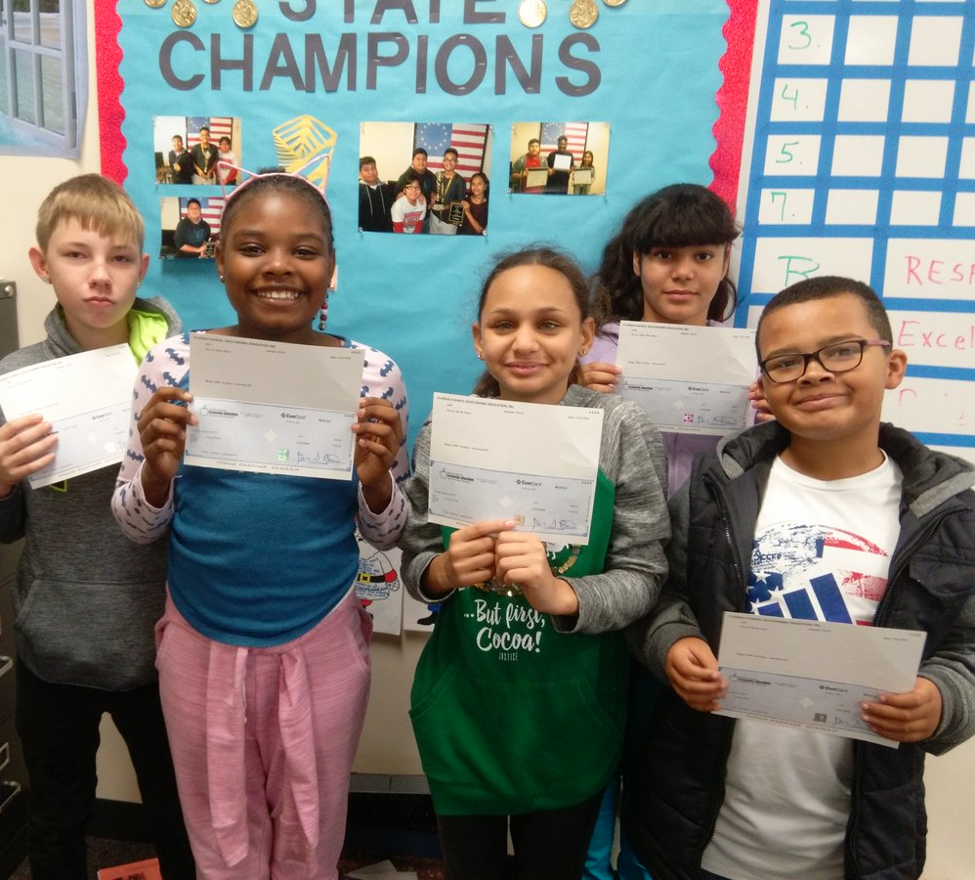
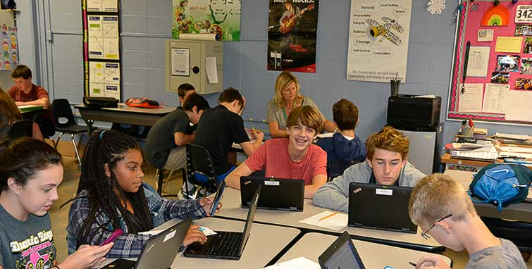
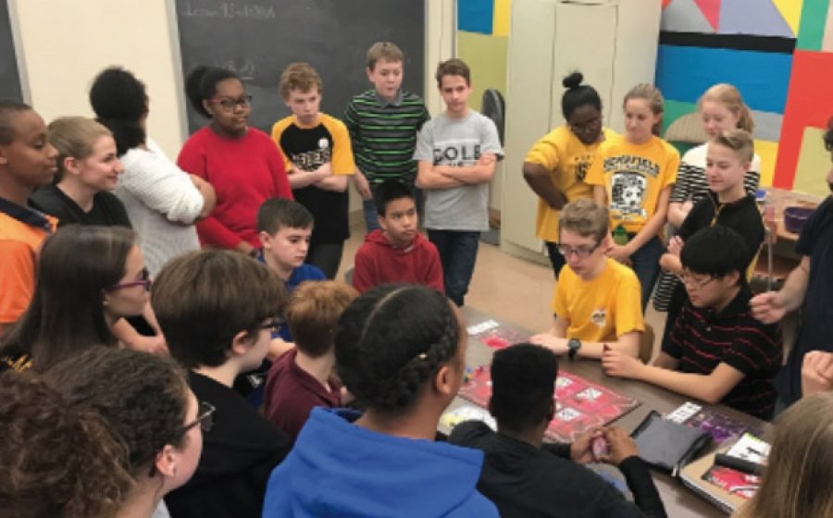
AVID
Are you determined to go to college?
AVID (Advancement Via Individual Determination) may be the course for you!
The AVID elective offers support to students who need help getting organized, want an opportunity to improve their study skills, and are interested in challenging themselves in Advanced classes.

Slide 9
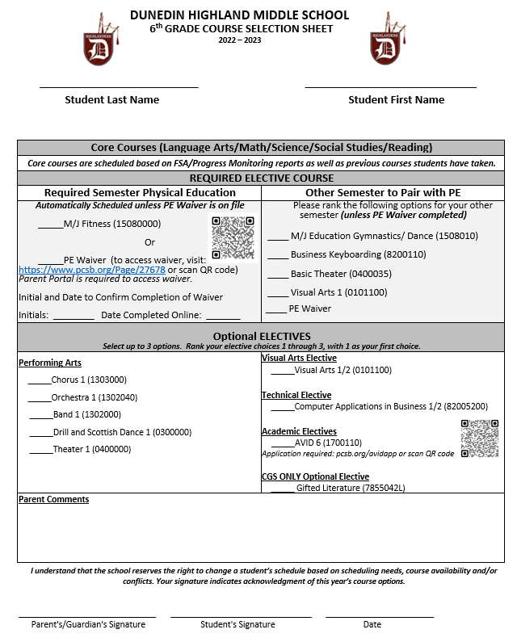
DHMS 2022-2023

Slide 10
How to Fill Out and Submit
Course Request Sheets
Students will be given 2 copies of the 6th Grade Course Sheet (one green and one white) to fill out.
Students will rank their elective choices in order of preference on the green sheet. Then we ask that they copy down that same info on the white copy.
Once both sheets are filled out (identical info.) the green copy will be collected right away, and the white copy should go home to be reviewed and signed by a parent/guardian.
Only a returned white copy will be reviewed to exempt you from PE
Colored copies will be used if no white copy is returned

Slide 11
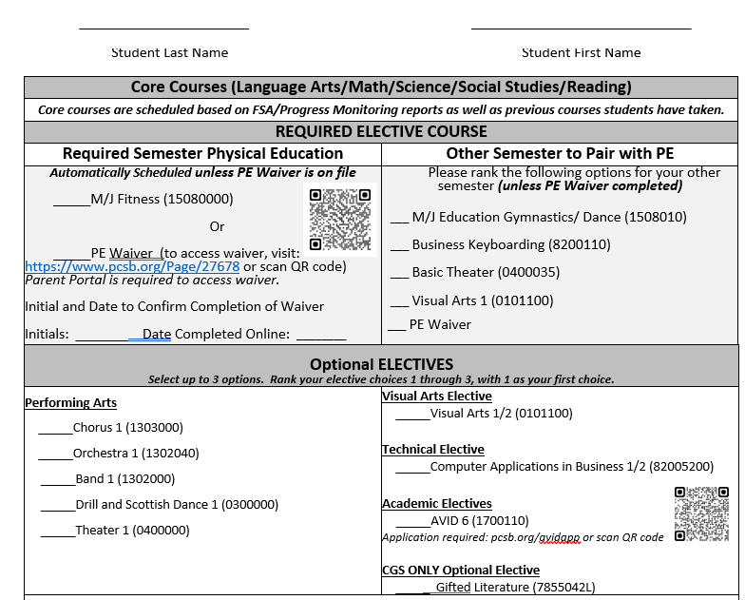
WHAT DO WE FILL OUT?
Make sure to fill out your name at the top
Review the elective options for what to pair with PE (everyone without a PE waiver will take PE for either a semester or the whole year).
Select your favorites and rank them.
Place a 1 by your 1st choice, put a 2 by your 2nd choice, & write a 3 by your 3rd choice
Review the Optional ELECTIVES
Select your favorites and rank them
Place a 1 by your 1st choice, put a 2 by your 2nd choice, & write a 3 by your 3rd choice

Slide 12
Course Selection
Fill out the top of the form
Write your last name
Write your first name
Review the elective options.
Select your favorites and rank them.
Place a 1 by your 1st choice, put a 2 by your 2nd choice, & write a 3 by your 3rd choice
Remember, you’re doing this twice… once for what to pair with PE and once for full year electives.
Copy the same elective choices on to white sheet.
Take white sheet home and discuss with your parent/guardian.
Get a parent signature at the bottom & then return it to your teacher ASAP.
(Print neatly)

Slide 13

6th Grade EXPO Night
Join us for our 6th Grade Expo Night on
Thursday, March 3rd 6:00pm
Notes:
https://pinellascountyschools-my.sharepoint.com/:f:/g/personal/doland_pcsb_org/EpxQoyXC4-FFgwkrZm4WAPgBLqfmkIoAiEGE7owpqTLyMw?e=7x8uaR

